Slide 1
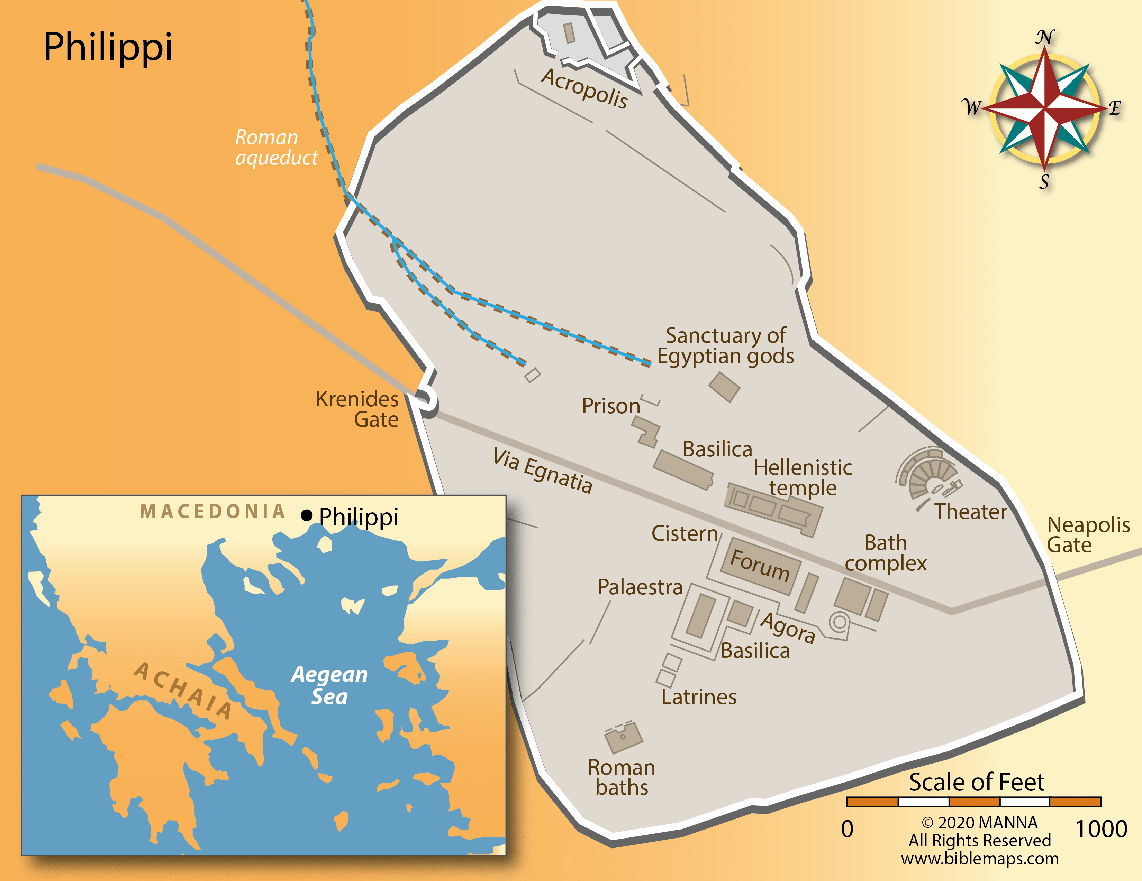
Philippi
A Roman colony founded for retired army veterans
(Acts 16.12)
A city where Roman citizenship was prized
(Acts 16.37-39)

Slide 2
What’s A Colony?
Definition: an area under the control of another country, occupied by settlers from that country.
Purpose: to replicate a particular culture in a foreign place.

Slide 3
What Does A Colony Bring?
New language to speak (Acts 16.15)
New customs to practice (Acts 16.21)
New king to serve (Acts 16.31)
New ideas to think (Acts 16.17)

Slide 4
Colonists of Heaven
Pressing On Toward the Goal

Slide 5
What Does Pressing On Mean?
Forgetting (vs. 13)
Straining (vs. 13)
Holding (vs. 16)

Slide 6
Why Press On?
Because Jesus has already pressed
on to you and me (vs. 12)

