Slide 1
The Peace of Jesus
Ephesians 2.11-18

Slide 2
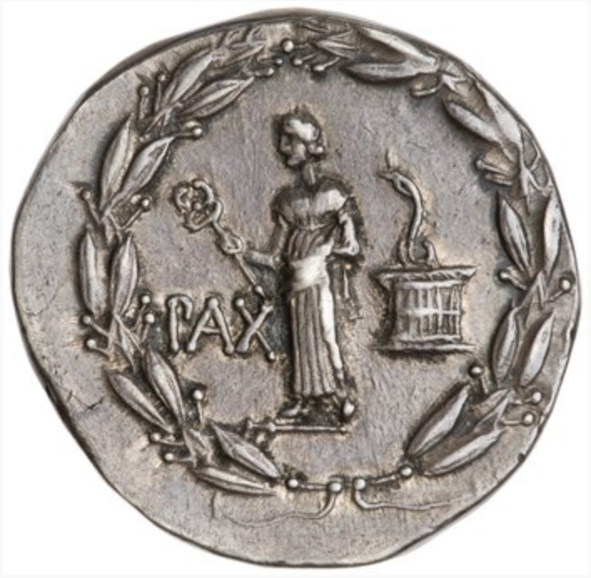
The Pax Romana (Peace of Rome)

Slide 3
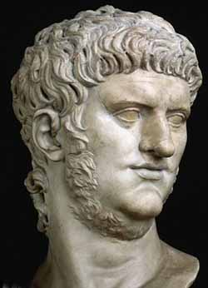
What Nero’s Tutor Made Him Recite
“I am the arbiter of life and death for the nations; it rests in my power what each man’s lot and state shall be; by my lips Fortune proclaims what gift she would bestow on each human being; from my utterance peoples and cities gather reasons for rejoicing; without my favor and grace no part of the wide world can prosper…”

Slide 4
What Nero’s Tutor Made Him Recite
“All those many thousands of swords which my peace restrains will be drawn at my nod; what nations shall be utterly destroyed, which banished, which shall receive the gift of liberty, which have it taken from them, what kings shall become slaves and whose heads shall be crowned with royal honor, what cities shall fall and which shall rise - this it is mine to decree.”

Slide 5
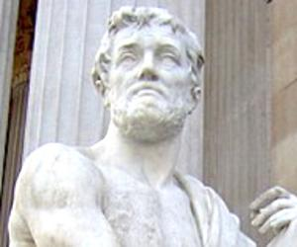
What A Roman Historian Thought About “Peace”
“The Romans call it empire, it is in fact murder and rapine and profit; they make a desolation and they call it peace.”

Slide 6
Jesus Creates REAL Peace
Ephesians 2.11-18
His peace actually leads to oneness.
He has crushed all obstacles that prevent peace.

Slide 7
We are brought together by giving ourselves up, just as He did.

