Slide 1
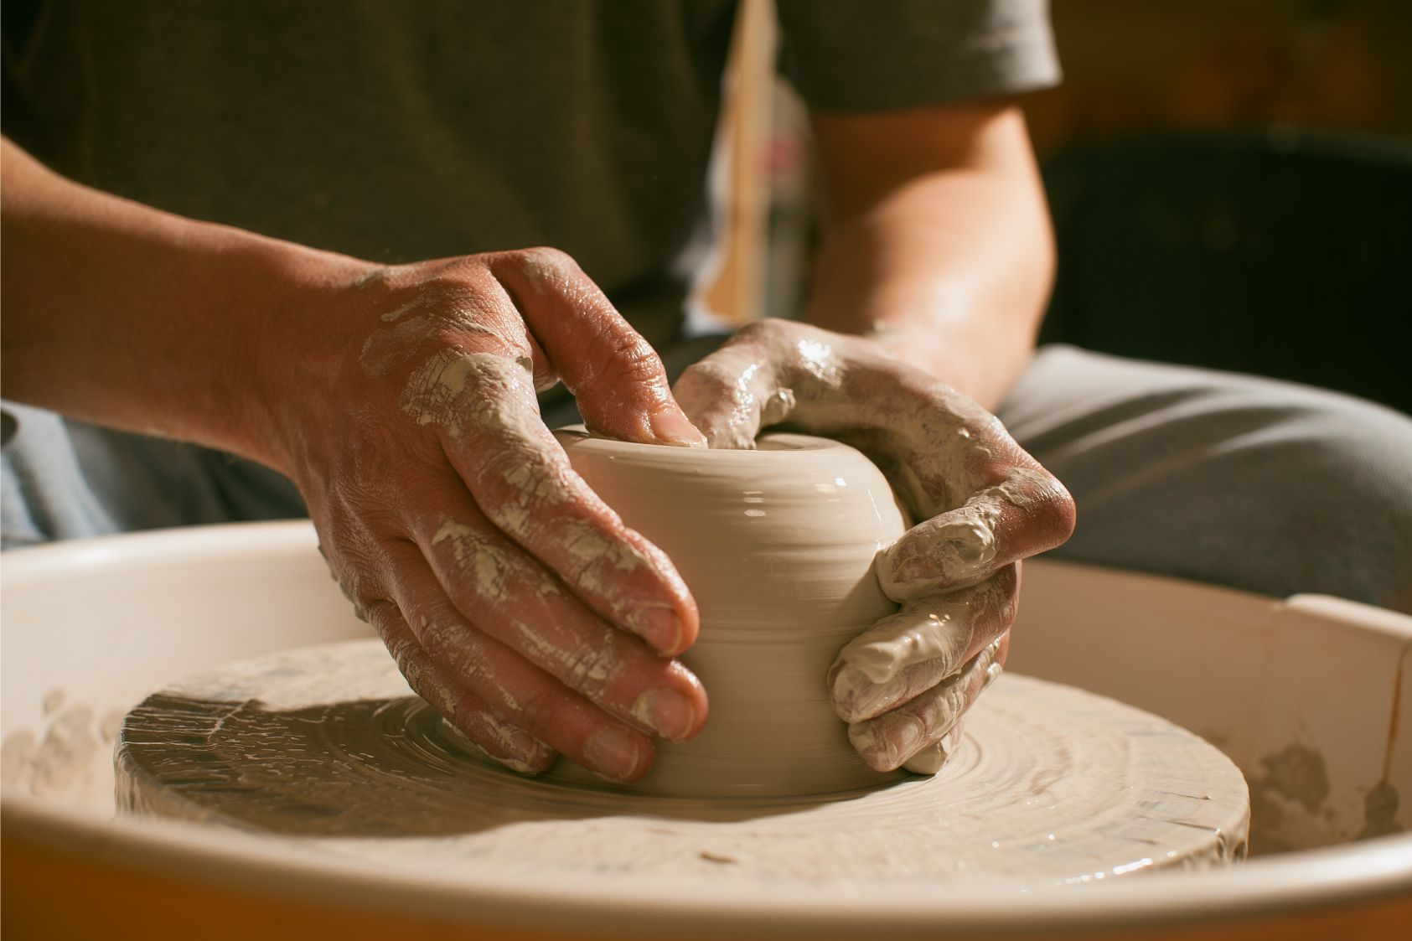
Created in Christ Jesus for good works
Ephesians 2:10

Slide 2
But now, O Lord, you are our Father; we are the clay, and you are our potter; we are all the work of your hand.
Isaiah 64:8
But who are you, O man, to answer back to God? Will what is molded say to its molder, “Why have you made me like this?” Has the potter no right over the clay, to make out of the same lump one vessel for honorable use and another for dishonorable use?
Romans 9:20-21

Slide 3
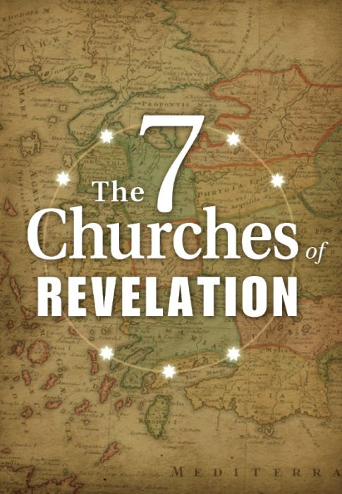
To the angel of the church in Ephesus write: ….
I know your works, your toil and your patient endurance,….
….yet this you have: you hate the works of the Nicolaitans, which I also hate.
Revelation 2:1-2,6
And to the angel of the church in Thyatira write:…
…I know your works, your love and faith and service and patient endurance, and that your latter works exceed the first.
Revelation 2:18
And to the angel of the church in Sardis write:…
I know your works. You have the reputation of being alive, but you are dead. Wake up, and strengthen what remains and is about to die, for I have not found your works complete in the sight of my God.
Revelation 3:1,2-3

Slide 4
And to the angel of the church in Philadelphia write: ….
I know your works. Behold, I have set before you an open door, which no one is able to shut. I know that you have but little power, and yet you have kept my word and have not denied my name.
Revelation 3:7,8
And to the angel of the church in Laodicea write: …
I know your works: you are neither cold nor hot. Would that you were either cold or hot!
Revelation 3:14,15

Slide 5
And you were dead in the trespasses and sins in which you once walked, following the course of this world, following the prince of the power of the air, the spirit that is now at work in the sons of disobedience—among whom we all once lived in the passions of our flesh, carrying out the desires of the body and the mind, and were by nature children of wrath, like the rest of mankind.
But God, being rich in mercy, because of the great love with which he loved us, even when we were dead in our trespasses, made us alive together with Christ—by grace you have been saved— and raised us up with him and seated us with him in the heavenly places in Christ Jesus, so that in the coming ages he might show the immeasurable riches of his grace in kindness toward us in Christ Jesus.
For by grace you have been saved through faith. And this is not your own doing; it is the gift of God, not a result of works, so that no one may boast. For we are his workmanship, created in Christ Jesus for good works, which God prepared beforehand, that we should walk in them.
Ephesians 2: 1-10

Slide 6
Therefore, brothers, since we have confidence to enter the holy places by the blood of Jesus, by the new and living way that he opened for us through the curtain, that is, through his flesh, and since we have a great priest over the house of God, let us draw near with a true heart in full assurance of faith, with our hearts sprinkled clean from an evil conscience and our bodies washed with pure water.
Let us hold fast the confession of our hope without wavering, for he who promised is faithful. And let us consider how to stir up one another to love and good works, not neglecting to meet together, as is the habit of some, but encouraging one another, and all the more as you see the Day drawing near.
Hebrews 10:19-25

Slide 7

Nor do people light a lamp and put it under a basket, but on a stand, and it gives light to all in the house. In the same way, let your light shine before others, so that they may see your good works and give glory to your Father who is in heaven.
Matthew 5:15-16
And let us not grow weary of doing good, for in due season we will reap, if we do not give up. So then, as we have opportunity, let us do good to everyone, and especially to those who are of the household of faith.
Galatians 5:9-19

Slide 8

Show yourself in all respects to be a pattern of good works
Titus 2:7
…who gave himself for us to redeem us from all lawlessness and to purify for himself a people for his own possession who are zealous for good works.
Titus 2:14
The saying is trustworthy, and I want you to insist on these things, so that those who have believed in God may be careful to devote themselves to good works. These things are excellent and profitable for people.
Titus 3:8
And let our people learn to devote themselves to good works, so as to help cases of urgent need, and not be unfruitful.
Titus 3:14
Titus

Slide 9
Let a widow be enrolled if she is not less than sixty years of age, having been the wife of one husband, and having a reputation for good works: if she has brought up children, has shown hospitality, has washed the feet of the saints, has cared for the afflicted, and has devoted herself to every good work.
1 Timothy 5:9-10

Slide 10
Now there was in Joppa a disciple named Tabitha, which, translated, means Dorcas. She was full of good works and acts of charity. In those days she became ill and died, and when they had washed her, they laid her in an upper room. Since Lydda was near Joppa, the disciples, hearing that Peter was there, sent two men to him, urging him, “Please come to us without delay.”
So Peter rose and went with them. And when he arrived, they took him to the upper room. All the widows stood beside him weeping and showing tunics and other garments that Dorcas made while she was with them.
Acts 9:36-39

Slide 11
But exhort one another every day, as long as it is called “today,” that none of you may be hardened by the deceitfulness of sin. For we have come to share in Christ, if indeed we hold our original confidence firm to the end.
Hebrews 3:13-14
Imagine the impact to:
  Your relationships
  Your influence for God
  Your faith
  Your sense of purpose and contentment

